Slide 1
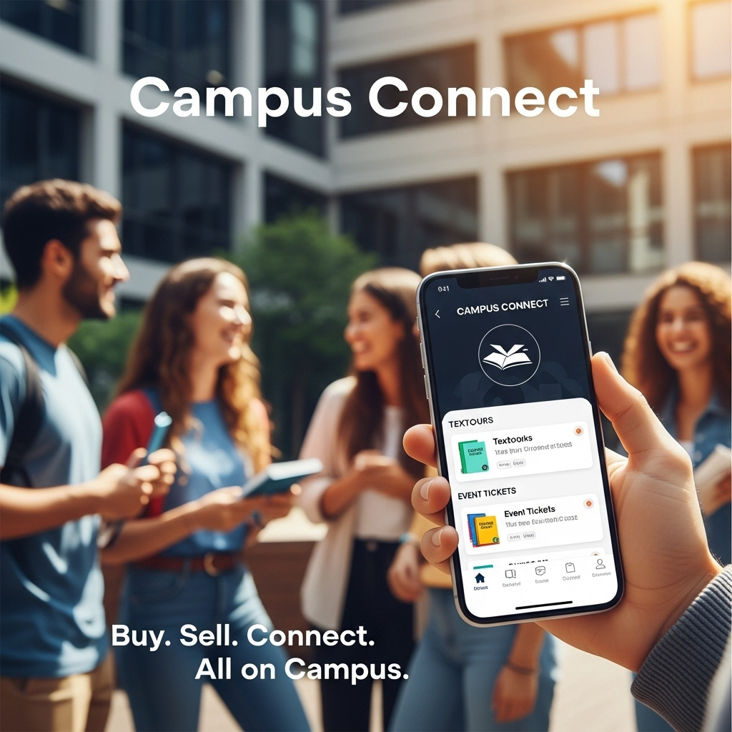
Start-Up Pitch Deck
by Campus Connect

Slide 2
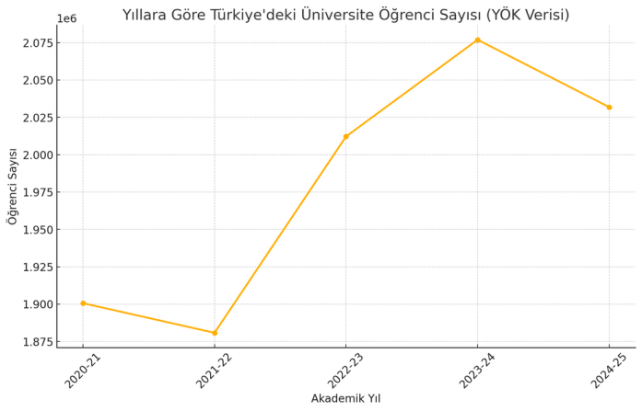
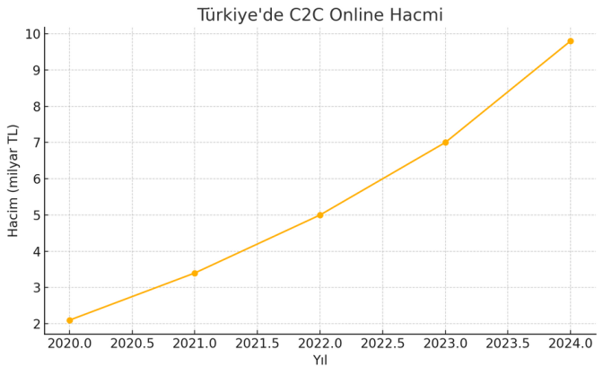
Students and E-Commerce Grows Together in Türkiye
Turkey's 7.08 million university students, spending 400-650 EUR monthly with 91% smartphone adoption, represent an underserved segment in the rapidly growing e-commerce market (25.18% CAGR) dominated by generic platforms charging 15-23% commissions.

Slide 3

What are university students trying to get done on campus?
To buy, sell, and rent student-specific items (textbooks, notes, equipment) easily and affordably
To connect with verified peers from their own university for social events, study
groups, and dating
To avoid the risk and high costs of dealing with anonymous users and generic
nationwide platforms

Slide 4
Core Pain Points
High Costs & Fees
Generic C2C platforms charge steep
commissions (15–23%) and high shipping costs, directly
impacting students’ limited finances.
Lack of Trust & Safety
Open platforms with unverified
users create low-trust environments for both
transactions and meetups.
Fragmented Experience
Students juggle multiple
apps—Trendyol for e-commerce, others for social
needs—creating an inconvenient campus experience.
Unmet Niche Needs
Mainstream platforms don’t
support student-specific use cases like note-trading,
calculator rentals, or tutoring services

Slide 5

No integrated social features. E-commerce platforms are purely transactional and miss
the opportunity to foster real student community and connection.
Main platforms (e.g., Dolap, Sahibinden.com) are generic and nationwide. They aren’t
designed for local, campus-based exchanges—resulting in shipping, coordination, and
trust issues.
They prioritize volume, not community. Their business models focus on scale and high
fees, not on creating safe, tailored student environments.
Platform Limitations

Slide 6
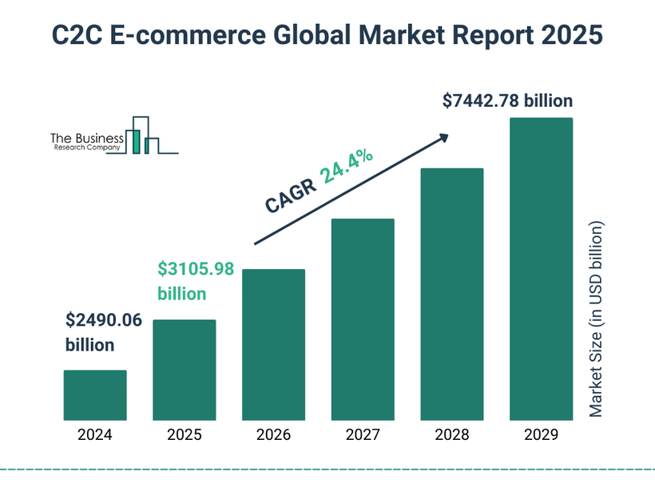
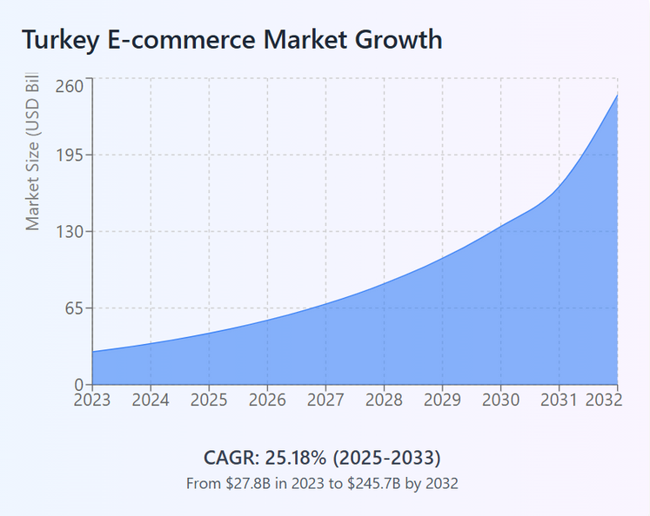
www.businessresearchcompany.com (2024).
Statista (2024).
With the right investments on its development, Campus Connect have a potential to evolve into more broad e-commerce platform, not only for the students, but also for a wider customer base. However, at this stage, our target is university students in Türkiye.

